Slide 1

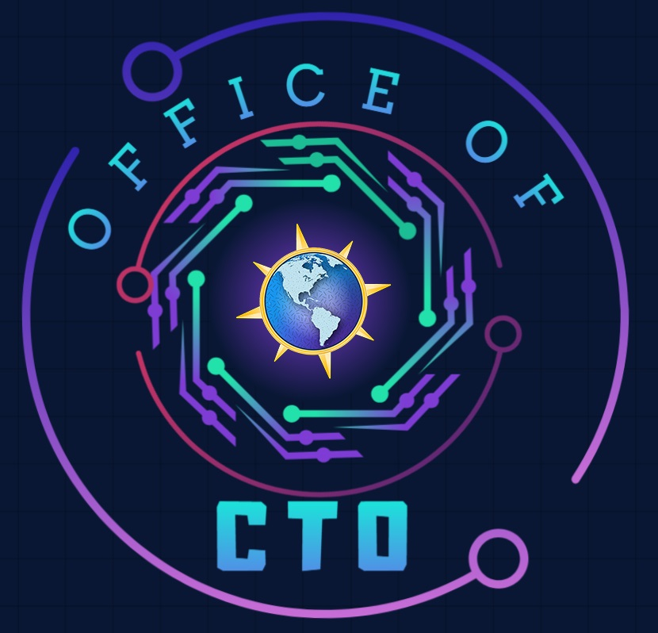

Microsoft Microhack
RAG AI & Your Data
Presented by
Americas Office of the CTO

Slide 2
Agenda
Welcome & Introduction | 10 mins | 11:00 – 11:10 A.M. (EST)
Setting the Stage | 40 mins | 11:10 – 11:50 P.M. (EST)
Hands-On Hack | 120 mins | 11:50 – 1:50 P.M. (EST)
Break | 10 mins | 1:50 – 2:00 P.M. (EST)
Show & Tell | 45 mins | 2:00 – 2:45 P.M. (EST)
Close | 15 mins | 2:45 – 3:00 P.M. (EST)

Slide 3

Welcome & Introductions
1

Slide 4

Microhack Goals
We Build technical skills through hands-on application in key areas, while fostering a sense of community and collaboration.
Make it Real Learning: Hands-on experience that translates directly to customer solutions
Leverage Key Resources: Access essential tools and demos for continuous learning.
Deepen Expertise: Build critical technical skills in priority areas
Collaborative Learning: Work with peers and experts in a team-driven setting
Lasting Impact: Equip teams to deliver more value and innovation to customers

Slide 5
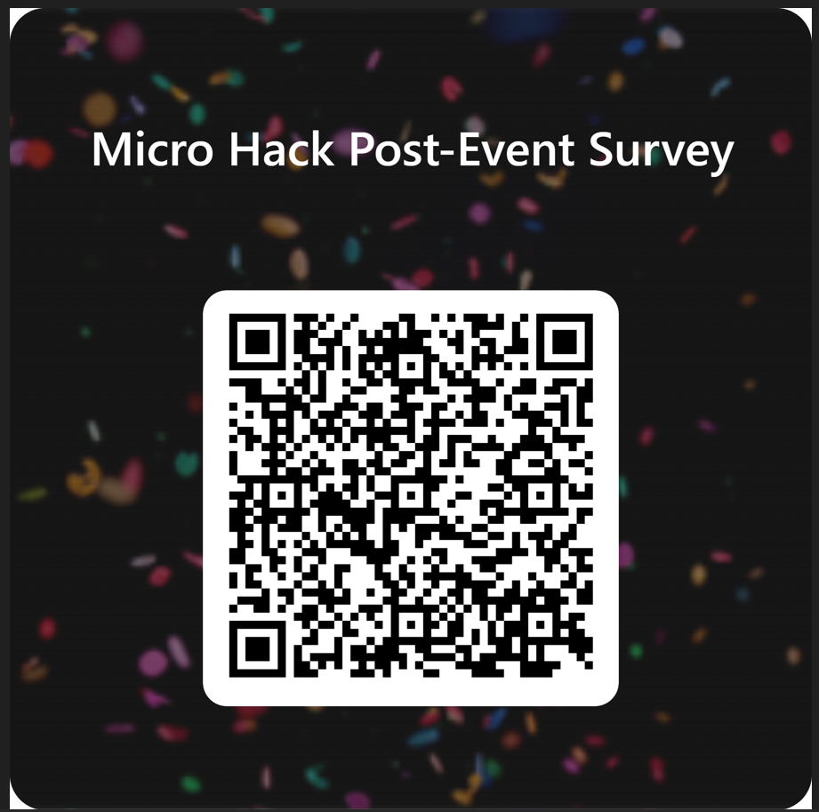
Microhack Feedback
Your feedback is essential for shaping future Microhacks and enhancing the experience.
We want to hear from you!
Microhack Feedback Form

Slide 6
Agenda
Welcome & Introductions | 10 mins | 11:00 – 11:10 A.M. (EST)
Setting the Stage | 40 mins | 11:10 – 11:50 P.M. (EST)
Hands-On Hack | 120 mins | 11:50 – 1:50 P.M. (EST)
Break | 10 mins | 1:50 – 2:00 P.M. (EST)
Show & Tell | 45 mins | 2:00 – 2:45 P.M. (EST)
Close | 15 mins | 2:45 – 3:00 P.M. (EST)

Slide 7
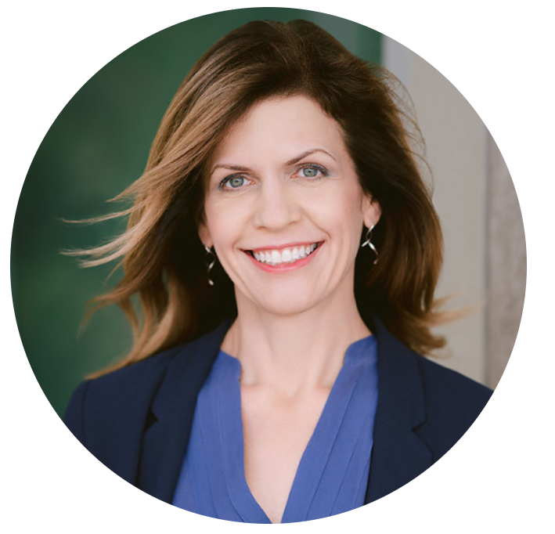




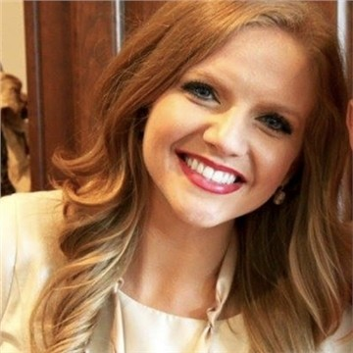

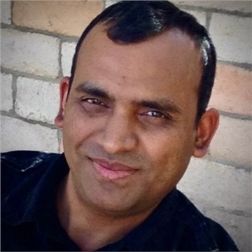
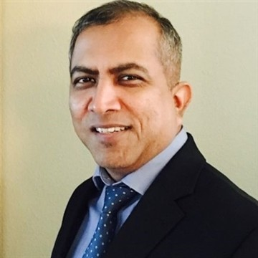

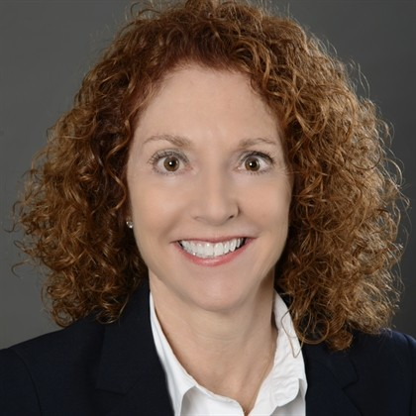



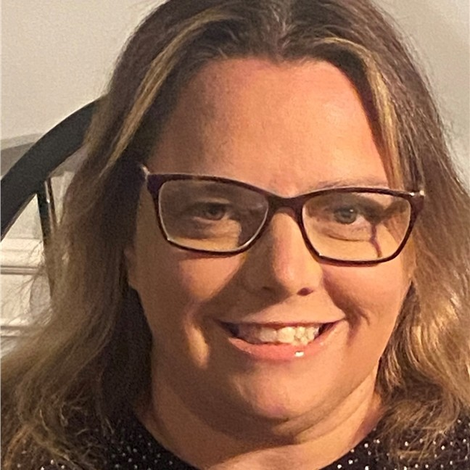

Office of the CTO
Executive
Sponsors
Lara Rubbelke
Americas Chief Technology Officer
David Lochridge
CSU GM, FSI
Mike DeSilver
GM, Americas CSU
AI Microhack
Tech Leads
James Tooles
Chief Architect
(OCTO)
John Savill
Chief Architect
(OCTO)
Kathryn Papandrew
Chief Architect
(OCTO)
Stephen Kaufman
Chief Architect
(OCTO)
Amit Agrawal
Chief Architect
(Americas CSA Team)
Lalit Patel
Prin CSA
(Americas CSA Team)
Amul Chapla
Lead CSA
(FSI)
Management
Team
Amy Machi
Chief of Staff
Brooke Egan Sanders
Title
Sommer Serie
Title
Alphie Aiken
Title
Lori Mulroony
Title
Jane Hess
Customer Partner Engagement & Executive Comms

Slide 8

Office of the CTO
Microsoft Americas OCTO
Get to know our team
Lara Rubbelke
Americas Chief Technology Officer
Angie Olson
Executive Assistant
Amy Machi
Chief of Staff
Jane Hess
Customer Partner Engagement & Executive Comms
James Tooles
Chief Architect
John Savill
Chief Architect
Kathryn Papandrew
Chief Architect
Stephen Kaufman
Chief Architect
Amit Agrawal
Chief Architect
Notes:
Enterprise architects:
Collaborate with product engineering
Amplify voice of the customer
Provide technical thought leadership to Americas technical community
Architect cloud solutions

Slide 9
Office of the CTO
Dedicated to delivering the most impactful outcomes for Microsoft and its customers through strategic collaboration, innovation, and adaptability. Our mission is to drive customer success, technical excellence, and AI transformation by leveraging our diverse skill set and fostering a culture of continuous learning, growth, and seamless engagement.
Core Areas of Focus
Accelerate Customer Success: Work directly with strategic customers to help them realize the full value of their most complex opportunities
Amplify Technical Excellence: Create a platform to learn, share, and strengthen our technical community through code and technology
Strengthen Americas Sales: Equip the Americas Sales organization with the right technical information to build and retain customer trust and lead them to long-term success
Influence Product Improvements: Collaborate closely with Product Engineering to relay customer feedback and depth insights to ensure products and services align with consumer demands
Build Strong Market Presence: Drive future customer success through a strong technical presence that highlights customer achievements and application patterns

Slide 10
Setting the Stage
2

Slide 11
Agenda
Welcome & Introduction | 20 mins | 11:00 – 11:20 A.M. (EST)
Setting the Stage | 40 mins | 11:20 – 12:00 P.M. (EST)
Hands-On Hack | 110 mins | 12:00 – 1:50 P.M. (EST)
Break | 10 mins | 1:50 – 2:00 P.M. (EST)
Show & Tell | 45 mins | 2:00 – 2:45 P.M. (EST)
Close | 15 mins | 2:45 – 3:00 P.M. (EST)

Slide 12





Microsoft Microhack
RAG AI & Your Data
Overview
Hack
Break
Show & Tell
Closing
Outline the Microhack experience, review customer scenario and related technologies.
Participants will work in teams to complete hands-on lab by tackling a series of challenges.
Break for all participants.
Teams will take turns providing a presentation to showcase their accomplishments and methods during the Microhack.
Review of Microhack accomplishments and guide the participants for continuing their journey.
1
2
3
4
5
60 minutes
110 minutes
10 minutes
45 minutes
15 minutes
You are HERE

Slide 13
Microsoft Microhack
Who you will be working with:
What you will be working on:
Join your assigned team of 3-6 participants
Join your Teams Break-Out channel
Coaches available to help
Main channel will display schedule and remain open for coach requests.
Share Challenge completion updates in Main Teams channel
Microsoft Teams – use to collaborate with your Microhack team
Azure – Microhack development environment
Microhack Challenges packet – complete challenges to complete Microhack successfully
Search Service Deployment
Creating Vector Indexes
Querying Vector Indexes
Integrating RAG into existing application
Advanced Challenges (Optional)

Slide 14
Customer Scenario | Contoso
Who is Contoso?
Technology company
Enormous product portfolio
Rapidly growing product ecosystem
Desperate legacy product documentation
What is Contoso trying to accomplish?
Consolidate product catalog
Streamline and modernize product documentation
Increase easy-of-use of product catalog understanding

Slide 15
Rules of Engagement
Dos
Invest in yourself. This is your training and your dedicated time for training. Make the most of it.
Contribute to the team.
You can finish in the time allotted, but you will need the time and group collaboration in order to finish.
Share completion information in the main team channel.
Don’t
Leave your team for extended periods of time.
Give up (ask if you need help).

Slide 16
Bringing domain knowledge to LLMs
Prompt engineering
In-context learning
Fine tuning
Learn new skills
Retrieval augmentation
Learn new facts
Notes:
There are generally three ways to apply domain knowledge and share your data with your LLMs.
Sometimes you can get the job done by simply doing prompt engineering. This is particularly the case when you have a static situation and a single prompt where you can work on it until gives you the answers you want and then you are set.
Other times, fine-tuning can be an interesting option. While fine-tuning is not necessarily great for learning new facts, it's actually really good when you need your app to learn skills, for example, like company jargon, providing a different “tone” of response, etc.
Now, when it comes to learning facts, based on data that your application or your organization produces, retrieval-augmentation is the pattern to go for.

Slide 17








Retrieval-Augmented Generation High-level Architecture
Retrieval system
Data Sources
User question
Answer
App UX
Orchestrator
Large Language Model
Notes:
If you’re going to use your own data in your GenAI app, Azure AI Search acts as the retrieval system in your RAG architecture: It incorporates the most relevant, domain specific knowledge for every query, so your application provides the responses you expect.
A common way to describe RAG is that you are “grounding” your AI application with your data.
If you are building an app using an AI model, you probably want to create an experience based on your own data, versus public web data. RAG is a way to incorporate your data into your GenAI application.
Out of the box, an AI model has a limited set of knowledge. RAG enables your app to learn new facts or knowledge outside what the model was originally trained on. This way, your app isn’t limited to a static/outdated dataset.
An important point to note, that with RAG, the knowledge you provide is externalized, and not incorporated into the model itself. This ensures you remain in control of your data, at all times.
When implementing RAG, a critical component is the "Retrieval system" which surfaces the right information from your data, that's needed to answer any particular question or interaction.
From there, you use the language model like Azure OpenAI GPT to apply reasoning and produce a relevant response.
When customers build their GenAI applications, Azure AI Search is used as the "retrieval system" in their RAG stack.

Slide 18
Text input that provides some framing as to how the engine should behave
Prompt
You are an intelligent assistant helping Contoso, Inc. employees with questions about their healthcare plan as well as the employee handbook. Answer the following question using only the data provided in the sources below.
Question: Does my health plan cover annual eye exams?
Sources:
Northwind Health Plus offers coverage for vision exams, glasses, and contact lenses, as well as dental exams, cleanings, and fillings.
Northwind Standard only offers coverage for vision exams and glasses.
Both plans offer coverage for vision and dental services.
Response
Based on the information provided, if your plan is with Northwind Standard, it does cover vision exams.
User provided question that needs to be answered
Sources used to answer the question
Notes:
Combining your data with prompts is a powerful concept. In this example, a question-answering prompt is used with 3 distinct pieces. The prompt starts with framing, providing the Generative AI with the context it needs on how to behave. The user-provided question is clearly defined separate from the framing. Finally, clearly formatted sources are provided at the bottom of the prompt. The Generative AI synthesizes all this information together and produces a correct response. Note, this is just an example and you may want to consider thing in your prompt like instructions to reference citations in sources, explitcly stating “I don’t know” when the data is not in the data sources”, etc.

Slide 19

What happens if the results the user is expecting are not returned as part of the top sources used to answer the question?
Text input that provides some framing as to how the engine should behave
Prompt
You are an intelligent assistant helping Contoso, Inc. employees with questions about their healthcare plan as well as the employee handbook. Answer the following question using only the data provided in the sources below.
Question: Does my health plan cover annual eye exams?
Sources:
Northwind Standard only offers coverage for vision exams and glasses.
Both plans offer coverage for vision and dental services.
Source that wasn’t picked since your most relevant results were not on top:
3. Northwind Health Plus offers coverage for vision exams, glasses, and contact lenses, as well as dental exams, cleanings, and fillings.
Response
Based on the information provided, if your plan is with Northwind Standard, it does cover vision exams.
User provided question that needs to be answered
Top sources used to answer the question
Relevant result that wasn’t provided as part of the top sources
If retriever doesn’t return the most relevant results the answer is not complete
Notes:
Consider this scenario where there's a highly relevant result, but it wasn't included in the top sources provided. In this case, the result is practically invisible to the system. This illustrates the significance of the retriever's role.
If the retriever fails to return the most relevant results, it directly affects the completeness and accuracy of the final answer. Remember, the RAG model relies heavily on the retriever to pull in the most pertinent documents or data to generate the best possible response.

Slide 20
Evaluating RAG: Best Practices
Model evaluation
Evaluate your model regularly using various metrics to ensure it meets your desired outcomes.
Understand user intent
Classify user intents as navigational, informational, or transactional. This aids in tailoring responses effectively.
Identify query types
Concept-seeking, fact-seeking, keyword, low query/doc term overlap, misspelled, long, medium, and short queries help uncover user intent and evaluate system performance.
Use comprehensive metrics
Employ a mix of lexical-based (Precision and Recall, F1 Score, Word Error Rate), semantic-based (Semantic Textual Similarity, Word Embedding Similarity, BLEU), and combined metrics (ROUGE, BERTScore) for a holistic evaluation.
Keep in mind top K (@K) retrieved Chunks
Granular perspective on how many Chunks to retrieve.
Implement ranking metrics
Utilize Recall@K, Mean Reciprocal Rank, Mean Average Precision@K, and Normalized Discounted Cumulative Gain for assessing the ranking quality of the system.
Regularly monitor performance
Continuously track and optimize the system's performance using these metrics to ensure the highest level of user satisfaction and system effectiveness.
User feedback
Incorporate user feedback to improve system for utility.
Azure’s RAG Evaluation Tool: Azure ML Prompt Flow!
Notes:
Here are some best practices when evaluating RAG:
Model Evaluation: Evaluate your model regularly using various metrics to ensure it meets your desired outcomes.
Understand User Intent: Classify user intents as navigational, informational, or transactional. This aids in tailoring responses effectively.
Identify Query Types: Concept-seeking, fact-seeking, keyword, low query/doc term overlap, misspelled, long, medium, and short queries help uncover user intent and evaluate system performance.
Use Comprehensive Metrics: Employ a mix of lexical-based (Precision and Recall, F1 Score, Word Error Rate), semantic-based (Semantic Textual Similarity, Word Embedding Similarity, BLEU), and combined metrics (ROUGE, BERTScore) for a holistic evaluation.
Keep in mind top K (@K) retrieved Chunks: Granular perspective on how many Chunks to retrieve.
Implement Ranking Metrics: Utilize Recall@K, Mean Reciprocal Rank, Mean Average Precision@K, and Normalized Discounted Cumulative Gain for assessing the ranking quality of the system.
Regularly Monitor Performance: Continuously track and optimize the system's performance using these metrics to ensure the highest level of user satisfaction and system effectiveness.
User Feedback: Incorporate user feedback to improve system for utility.
Azure’s RAG Evaluation tool: Azure ML Prompt Flow!

Slide 21

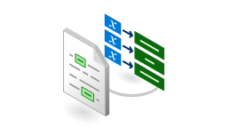
Anatomy of RAG
6
5&7
?
2
Search query/questions
(Including filters, facets, scoring profiles, etc.)
Section 1
User Query
Expert systems
Section 2
User
application
1
Document Chunking
Section 3
Azure AI
Search
index
N-relevant sections
Response:
summarization,
references, etc.
4
Orchestration
Section 4
Prompting
3
Document library
Azure AI Document Intelligence
Layout model
Azure OpenAI Service
1. Data ingestion
2. Chunking
3. Indexing
4. User interface
5. Orchestration
6. Data retrieving
7. Orchestration
Different data formats and system of records
What is the best Chunking strategy?
Shall I use vector embeddings data transformation, mappings?
Chatbot for Q&A surfaced to end users
Communication coordination and prompting—Prompt to get retriever query
Shall I use vector, semantic, keyword or hybrid approach?
Communication coordination: create user response based on retrieve data and send to User app
Notes:
Here we have a summary of RAG anatomy. this is a process involving several steps to facilitate efficient data retrieval and user interaction.
1. Data ingestion and preparation: This is the initial stage where data is collected and prepared for further processing. It involves collecting data from various sources, cleaning and organizing it for further use.
2. Chunking: This is a process of breaking down the data into manageable pieces or 'Chunks'. This allows for easier processing and analysis of the information, and to respect the maximum inputs of AI models.
3. Indexing: This step involves transforming data and using vector embeddings to create an AI search index. The idea is to map and organize the data in a way that makes it easily searchable. Vector embeddings are used to represent words or phrases in a numerical form that can be compared for similarity. Questions like whether to do data transformation, use vector embeddings, or any indexing mappings are addressed in this phase.
4. User Interface: This is the point of interaction between the user and the AI system. Here, users can input their queries to the chatbot, which uses Natural Language Processing (NLP) and the previously processed data to provide accurate and relevant responses.
5. Orchestration (Including prompt): This involves prompting the Language Model (LLM) to generate the retriever query. The system is prepared to ask specific questions based on the user's initial query and communicates with the retriever to get the most relevant responses.
6. Data Retrieving: This step involves deciding on the type of approach to use for data retrieval - vector, semantic, keyword or a hybrid approach. It also involves deciding on the use of filters, facets, scoring profiles and determining the number of results to be used.
7. Orchestration: After retrieving the data, it is once again communicated and coordinated with the LLM. The LLM is prompted to summarize the retrieved data and create a response that will be returned to the user. This response should contain the most relevant sections replied by the retriever (AI search).
For steps 2 and 3 highlighted in green, AI Studio, Azure OAI on your data and AI Search can help for many scenarios with the Chunking, Vectorization and data enrichment/transformation if needed and finally data indexing.

Slide 22











Microhack
Basic Architecture
Retrieval Augmented
Generation
CosmosDB
Entra ID
User
(Chat)
Web App
Orchestrator
Key Vault
User
(Document Upload)
Entra ID
Blob Storage
Data
Ingestion
AI Search
Azure OpenAI
Logging & Monitoring
Monitor
Network
Watcher
Log Analytics
Dialogistic
Settings
Application
Insights

Slide 23
Hands-On Hack
3

Slide 24
Agenda
Welcome & Introduction | 20 mins | 11:00 – 11:20 A.M. (EST)
Setting the Stage | 40 mins | 11:20 – 12:00 P.M. (EST)
Hands-On Hack | 110 mins | 12:00 – 1:50 P.M. (EST)
Break | 10 mins | 1:50 – 2:00 P.M. (EST)
Show & Tell | 45 mins | 2:00 – 2:45 P.M. (EST)
Close | 15 mins | 2:45 – 3:00 P.M. (EST)
GitHub: https://github.com/Boykai/octo-microhack-rag-ai-and-your-data

Slide 25
Break
4

Slide 26
Agenda
Welcome & Introduction | 20 mins | 11:00 – 11:20 A.M. (EST)
Setting the Stage | 40 mins | 11:20 – 12:00 P.M. (EST)
Hands-On Hack | 110 mins | 12:00 – 1:50 P.M. (EST)
Break | 10 mins | 1:50 – 2:00 P.M. (EST)
Show & Tell | 45 mins | 2:00 – 2:45 P.M. (EST)
Close | 15 mins | 2:45 – 3:00 P.M. (EST)

Slide 27
Show & Tell
5

Slide 28
Agenda
Welcome & Introduction | 20 mins | 11:00 – 11:20 A.M. (EST)
Setting the Stage | 40 mins | 11:20 – 12:00 P.M. (EST)
Hands-On Hack | 110 mins | 12:00 – 1:50 P.M. (EST)
Break | 10 mins | 1:50 – 2:00 P.M. (EST)
Show & Tell | 45 mins | 2:00 – 2:45 P.M. (EST)
Close | 15 mins | 2:45 – 3:00 P.M. (EST)

Slide 29
Instructions:
Each team will have 5 minutes to share their topics.
Make sure that everyone speaks
Make sure that everyone is on camera when they are speaking
There are no wrong answers and no penalty for not having finished (but we would love to know what held you back from finishing)
Topics to Share for Show & Tell:
Name one thing you learned
What was more difficult than you expected?
What surprised you the most?
What do you think will be the biggest pushback from your customer as they look to adopt this technology?
Did you have any showstoppers?

Slide 30
Close
6

Slide 31
Agenda
Welcome & Introduction | 20 mins | 11:00 – 11:20 A.M. (EST)
Setting the Stage | 40 mins | 11:20 – 12:00 P.M. (EST)
Hands-On Hack | 110 mins | 12:00 – 1:50 P.M. (EST)
Break | 10 mins | 1:50 – 2:00 P.M. (EST)
Show & Tell | 45 mins | 2:00 – 2:45 P.M. (EST)
Close | 15 mins | 2:45 – 3:00 P.M. (EST)

Slide 32
Microhack Feedback
Your feedback is essential for shaping future Microhacks and enhancing the experience.
We want to hear from you!
Microhack Feedback Form

Slide 33
End

